Slide 1

FPT University
Android programMing
Lesson 11
Version 1.0

Slide 2
Agenda
Overview of Threads
Thread Handlers
Thread example

Slide 3
Android Threads and Thread Handlers
Overview of Threads
Threads are the cornerstone of any multitasking operating system and can be thought of as miniprocesses running within a main process, the purpose of which is to enable at least the appearance of parallel execution paths within applications
When an Android application is first started, the runtime system creates a single thread in which all application components will run by default. This thread is generally referred to as the main thread

Slide 4
Android Threads and Thread Handlers
Thread Handlers
Never perform time-consuming operations on the main thread of an application
Rule is that the code within a separate thread must never directly update any aspect of the user interface.
In the event that the code executing in a thread needs to interact with the user interface, it must do so by synchronizing with the main UI thread. This is achieved by creating a handler within the main thread.
Notes:
Any changes to the user interface must always be performed from within the main thread. The reason for this is that the Android UI toolkit is not thread-safe. Attempts to work with non-thread-safe code from within multiple threads will typically result in intermittent problems and unpredictable application behavior. In the event that the code executing in a thread needs to interact with the user interface, it must do so by synchronizing with the main UI thread. This is achieved by creating a handler within the main thread.

Slide 5
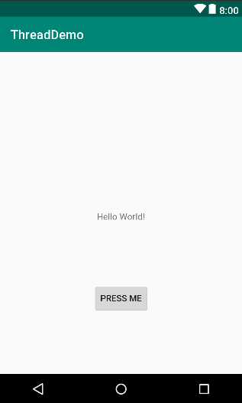
Android Threads and Thread Handlers
Threading Example

Slide 6
Android Threads and Thread Handlers
Try a comsumer time in main thread
public void onClick(View view) { long endTime = System.currentTimeMillis() + 10*1000; while (System.currentTimeMillis() < endTime){ synchronized (this){ try { wait(1000); }catch (Exception e){ } } } TextView textView = findViewById(R.id.textView); textView.setText("Button pressed"); }

Slide 7
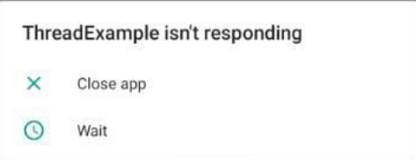
Android Threads and Thread Handlers
With multiple click on the button, the app maybe crashed.

Slide 8
Android Threads and Thread Handlers
Creating a New Thread
count++; Runnable runnable = new Runnable() { @Override public void run() { long endTime = System.currentTimeMillis() + 10*1000; while (System.currentTimeMillis() < endTime){ synchronized (this){ try { wait(1000); }catch (Exception e){ } } } } }; Thread thread = new Thread(runnable); thread.start(); TextView textView = findViewById(R.id.textView); textView.setText("Button pressed: " + count);

Slide 9
Android Threads and Thread Handlers
Thread handlers are implemented in the main thread of an application and are primarily used to make updates to the user interface in response to messages sent by other threads running within the application’s process.
Notes:
Try update UI without handler

Slide 10
Android Threads and Thread Handlers
Implementing a Thread Handler
final Handler handler = new Handler(){ @Override public void handleMessage(Message msg) { Bundle bundle = msg.getData(); String text = bundle.getString("myKey"); textView.setText(text); } };

Slide 11
Android Threads and Thread Handlers
Passing a Message to the Handler
while (System.currentTimeMillis() < endTime){ synchronized (this){ try { wait(1000); count++; Message msg = handler.obtainMessage(); Bundle bundle = new Bundle(); bundle.putString("myKey","Button pressed: " + count); msg.setData(bundle); handler.sendMessage(msg); }catch (Exception e){} } }

Slide 12

End of Lesson 11

Slide 13
Thank you!

